Slide 1

CYBER CRIME: HOTSPOT AND COLD SPOT VIEW ON U.S
ROHITH VS
BATCH : JULY 2023
Analytics Avenew On TechBoss Mega Internship 2023

Slide 2
Agenda
1
2
3
4
5
Introduction
Problem Statement
Approach
Dashboard and Insights
Conclution

Slide 3


Introduction
The cost of cybercrime could reach $10.5 trillion annually by 2025.
Targets range from individuals right up to governments and critical infrastructure.
Cybercriminals operate internationally, and we need international rules in order to crack down on them.

Slide 4
PROBLEM STATEMENT
Cybercrime Hotspots and Cold spots: A Geospatial Analysis by financial losses due to various types of cybercrime in all 50 states and Washington D.C. in the United States for the years 2020 and 2021.

Slide 5
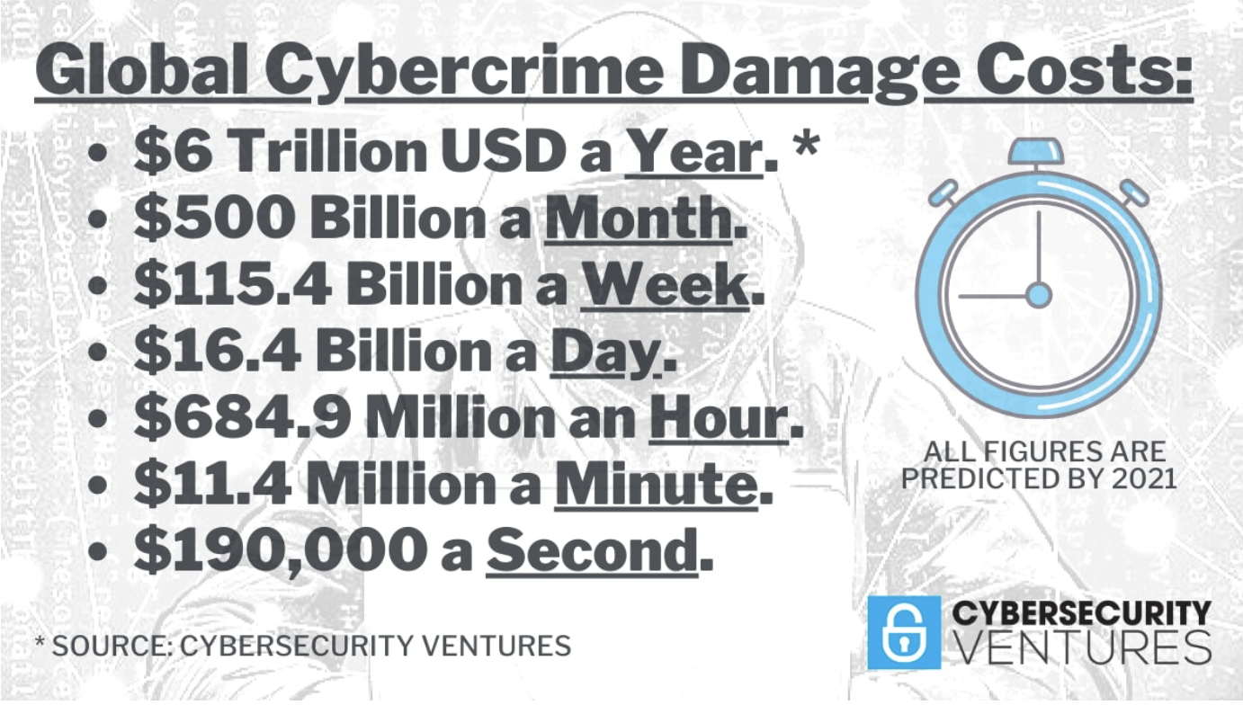
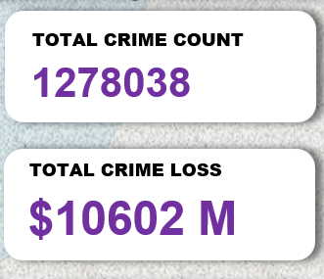
$10.3 Billion in Cyber Crime Losses Shatters Previous Totals - 2022

Slide 6
APPROACH
PHASE 1
Develop top 10 Hot Spot and Cold Spot and Total Values
Capitalize on Crime rate and crime loss
Visualize the Regions and the Total Values
PHASE 2
Iterative approaches to Types of Crime and Its Values
Establish Slicers and Tabs to Fetch custom data.

Slide 7
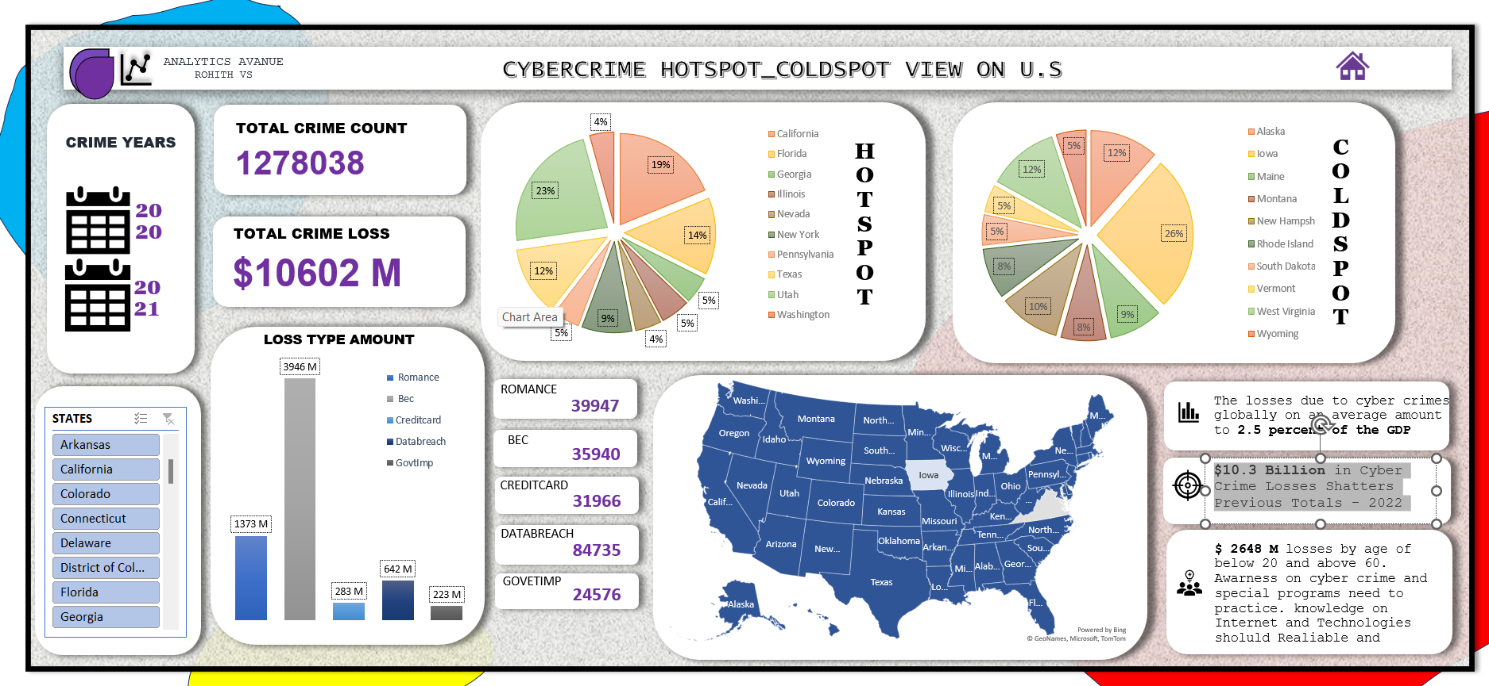


DASH BOARD
Flora Berggren
Rajesh Santoshi
Chief Operations Officer
VP Marketing

Slide 8
ARCHITURAL DESIGN
PHASE 1
PHASE 2

Slide 9





Tittle Ribbon
Dashboard Name and Home Button for Default View
Phase 1 Charts
Disseminate standardized on Total values and Hot Spot/Cold spot
Phase 2 Charts
Coordinate Chart on Types of crime and it count values
Custom Slicers
Foster way to view on custom Data and Values.
KPI’s
Insights and Derived KPI from Dash Board

Slide 10
INSIGHTS​
CRIME VALUES​
FUTURE RATES
KPI - INSIGHTS
$10.3 Billion in Cyber Crime Losses Shatters Previous Totals - 2022
U.S. dollars. Business e-mail compromise (BEC) ranked second, amounting to around 2.7 billion U.S.
2021’s total of $6.9 billion, according to the bureau’s Internet Crime Complaint Center (IC3) ​
cyberattacks will amount to about $10.5 trillion annually by 2025—a 300 percent increase from 2015 levels.​ world spent around $150 billion in 2021 on cybersecurity, growing by 12.4 percent annually.
$2 trillion market opportunity for cybersecurity technology and service providers. Cybercrime To Cost The World $10.5 Trillion Annually By 2025.
New Cyber Security Services and Technologies and Education and Skills will have massive Demand

Slide 11

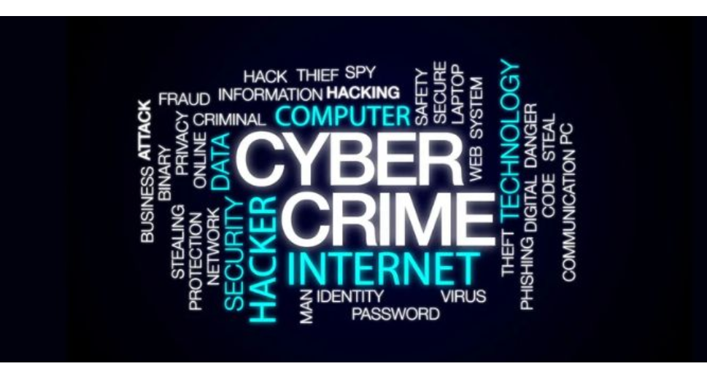
Conclusion
At Analysis on Data Sheet and Dash Board the Top Hot spot and Cold Spot Values and Counts the FINANICAL LOSSES by CYBER CRIME really an BIG OUTBREAK . The more it knowing the more it grows and mutates like Pandemic.
Awareness and Better Knowledge could zoom out the picture but not Disappear.

Slide 12


Thank you
ROHITH VS
samrohithvs@gmail.com.com
DataSheet link,
https://www.kaggle.com/datasets/husseinsalaudeen/us-internet-crime-2020-202

